Slide 1
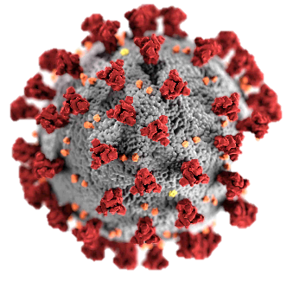



COVID-19 DASHBOARD PRESENTATION
This is the total number of confirmed cases of Covid-19 in the world is 603,000,000.
This is the total number of Death caused by Covid-19 in the world is 6,500,000.
This is the death rate of covid-19 in the world. It is calculated by dividing the confirmed cases by total death and then, multiplying the result by 100 which gives 1.08.

Slide 2
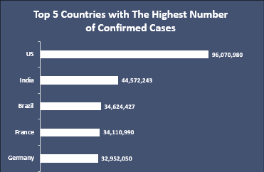
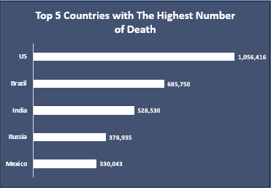
These are the top 5 countries that had the highest confirmed number of Covid-19 cases with The United States having 96,070,000 Cases.
These are the top 5 countries that recorded the highest number of deaths caused by Covid-19 with The United States having 1,056,000 deaths.

Slide 3
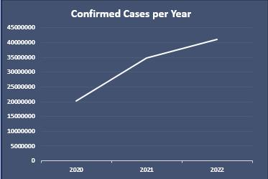
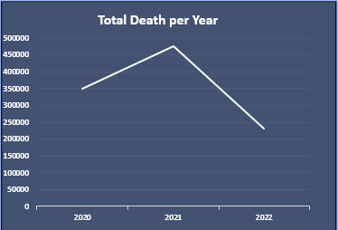
Total confirmed cases increased by 172% from 2020 – 2021 and increased by 119% from 2021 - 2022
Total number of deaths increased by 136% from 2020 – 2021 and increased by 49% from 2021 - 2022

